Slide 1
Data Analysis Portfolio - Vedant Phanasgaonkar

Slide 2
Professional Background
I hold a Bachelor's degree in Computer Science with a commendable CGPA of 8.5 and am currently pursuing a Master's in Computer Applications (MCA). I have developed a strong foundation in key areas such as Data Analysis, Python programming, Machine Learning, MySQL, Excel, Tableau, and Power BI. Throughout my academic journey, I have engaged in several personal projects that allowed me to apply my skills in Data Analysis, Machine Learning, Excel, and Python, enhancing my practical understanding of these concepts.
As a recent graduate, I am eager to tackle real-world challenges within a corporate environment. I pride myself on my flexibility and adaptability, which enable me to quickly learn and integrate new technologies and methodologies. While I possess substantial theoretical knowledge, I am keen to translate this into practical applications and contribute meaningfully to a team. I am confident that with dedication and effort, I will continue to grow and excel in my professional journey.

Slide 3
Table of Contents
Professional Background ------------ 2
Table of Contents ------------ 3-4
Data Analytics Process • Description ------------ 5 • Design ------------ 6-8 • Conclusions ------------ 9
Instagram User Analytics • Description ------------ 10 • The Problem ------------ 11-12 • Design ------------ 13 • Findings ------------ 14-20 • Analysis ------------ 21-22 • Conclusions ------------ 23
Operation Analytics and Investigating Metric Spike • Description ------------ 24 • The Problem ------------ 25-26 • Design ------------ 27 • Findings ------------ 28-39 • Analysis ------------ 40-41 • Conclusions ------------ 42
Hiring Process Analytics • Description ------------ 43 • The Problem ------------ 44 • Design ------------ 45 • Findings ------------ 46-50 • Analysis ------------ 51 • Conclusions ------------ 52

Slide 4
IMDB Movies Analysis • Description ------------ 53 • The Problem ------------ 54 • Design ------------ 55 • Findings ------------ 56-60 • Analysis ------------ 61 • Conclusions ------------ 62
Bank Loan Case Study • Description ------------ 63 • The Problem ------------ 64 • Design ------------ 65 • Findings ------------ 66-90 • Analysis ------------ 91-92 • Conclusions ------------ 93
Analyzing the Impact of Car Features on Price and Profitability • Description ------------ 94 • The Problem ------------ 95-96 • Design ------------ 97 • Findings ------------ 98-107 •Analysis ------------ 108-109 • Conclusions ------------ 110
ABC Call Volume Trend • Description ------------ 111 • The Problem ------------ 112 • Findings ------------ 113-117 • Analysis ------------ 118-119 • Conclusions ------------ 120
Appendix ------------ 121-122

Slide 5
1. Data Analytics Process
Description
We use Data Analytics in everyday life without even knowing it. For e.g. : Going to a market to buy something . Your task is to give the example(s) of such a real-life situation where we use Data Analytics and link it with the data analytics process.

Slide 6
Design
Real Life Scenario: Buying a Car
Plan
● Identify needs: I will determine what I need in a car (e.g., family car, sports car, fuel efficiency).
● Set a budget: Then decide how much I am willing to spend on the car.
● Research options: I will start researching different car models that meet my criteria.
Prepare
● Financing: Explore financing options such as loans, leases, or paying in cash.
● Gather information: Then I will collect data on different car models, including prices, features, reviews, and ratings.
● Check dealerships: Identify local dealerships or online platforms where I can purchase the car.

Slide 7
Process
● Compare models: I will compare various car models based on my criteria such as price, fuel efficiency, safety ratings, and features.
● Test drives: Then schedule test drives for the shortlisted models to get a hands-on experience.
● Evaluate costs: And also consider additional costs such as insurance, maintenance, and fuel efficiency.
Analyze
● Market trends: Analyze market trends to identify the best time to buy a car (e.g., end of the year, holiday sales).
● Depreciation: Study the depreciation rates of the cars I am interested in to understand their long-term value.
● Reviews and feedback: Read user reviews and expert feedback to gauge the reliability and performance of the cars.

Slide 8
Share
● Consult with others: Later I will discuss my findings with family, friends, or car experts to get their opinions and advice.
● Negotiate: Communicate with dealerships or sellers to negotiate the best price and terms.
● Finalize decision: Share my final decision with relevant parties, such as the dealership, insurance company, and finance provider.
Act
● Purchase: Lastly I will complete the purchase transaction, ensuring all paperwork is in order.
● Registration and insurance: Register the car and obtain the necessary insurance coverage.
● Enjoy your new car: Take possession of my new car and start enjoying my purchase.

Slide 9
Conclusions
Hence, we have seen how we can use the 6 steps of Data Analytics while making any decision in real life scenarios (Buying a Car).
The 6 steps used to take decisions in real life scenarios are:-
• Plan
• Prepare
• Process
• Analyze
• Share
• Act

Slide 10
2. Instagram User Analytics
Description
The aim of this project is to pull out actionable insights from raw data by utilizing different database management tools and to visualize these insights, ultimately improving the platform's efficiency.
SQL was used to execute the project, where queries helped build a database from the raw data. These queries then facilitated the sorting and extraction of data to uncover the necessary insights.
MySQL Workbench v8.0.40 was utilized as part of the tech stack, proving to be an excellent tool for database querying due to its easy access, simple configuration, intuitive graphical user interface, and effective troubleshooting support.

Slide 11
The Problem
A) Marketing Analysis:
1. Loyal User Reward: The marketing team wants to reward the most loyal users, i.e., those who have been using the platform for the longest time.
Your Task: Identify the five oldest users on Instagram from the provided database.
2. Inactive User Engagement: The team wants to encourage inactive users to start posting by sending them promotional emails.
Your Task: Identify users who have never posted a single photo on Instagram.
3. Contest Winner Declaration: The team has organized a contest where the user with the most likes on a single photo wins.
Your Task: Determine the winner of the contest and provide their details to the team.
4. Hashtag Research: A partner brand wants to know the most popular hashtags to use in their posts to reach the most people.
Your Task: Identify and suggest the top five most commonly used hashtags on the platform.
5. Ad Campaign Launch: The team wants to know the best day of the week to launch ads.
Your Task: Determine the day of the week when most users register on Instagram. Provide insights on when to schedule an ad campaign.

Slide 12
B) Investor Metrics:
1. User Engagement: Investors want to know if users are still active and posting on Instagram or if they are making fewer posts.
Your Task: Calculate the average number of posts per user on Instagram. Also, provide the total number of photos on Instagram divided by the total number of users.
2. Bots & Fake Accounts: Investors want to know if the platform is crowded with fake and dummy accounts.
Your Task: Identify users (potential bots) who have liked every single photo on the site, as this is not typically possible for a normal user.

Slide 13
Design
Steps followed to load the data into the database:
- A new schema named `ig_clone` was created in MySQL.
- The dataset was imported into MySQL and executed.
- All tables and data were successfully loaded into the database.
- The `SELECT` command can be used to retrieve the desired results from the database.

Slide 14
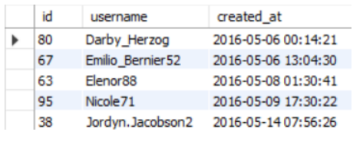
Findings
A) Marketing Analysis:
1. Loyal User Reward: The marketing team wants to reward the most loyal users, i.e., those who have been using the platform for the longest time.
Your Task: Identify the five oldest users on Instagram from the provided database.
Code: select * from users order by created_at limit 5;
Output:

Slide 15
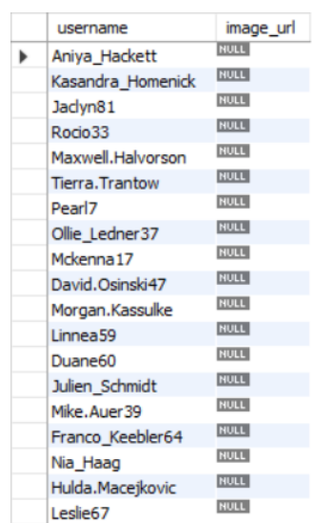
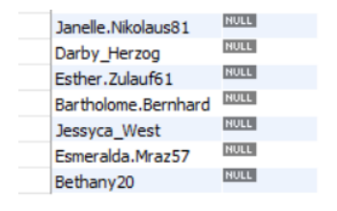
2. Inactive User Engagement: The team wants to encourage inactive users to start posting by sending them promotional emails.
Your Task: Identify users who have never posted a single photo on Instagram.
Code: select username, image_url from photos as p right join users as u on p.user_id = u.id where p.image_url is null;
Output:

Slide 16
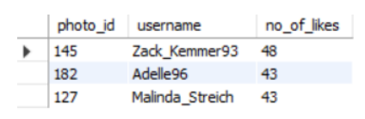
3. Contest Winner Declaration: The team has organized a contest where the user with the most likes on a single photo wins.
Your Task: Determine the winner of the contest and provide their details to the team.
Code: select likes.photo_id, users.username, count(likes.user_id) as no_of_likes from likes inner join photos on likes.photo_id = photos.id inner join users on photos.user_id = users.id group by likes.photo_id, users.username order by no_of_likes desc limit 3;
Output:

Slide 17
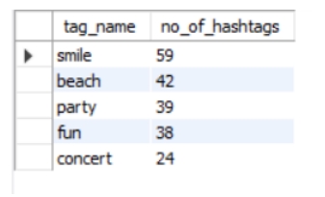
4. Hashtag Research: A partner brand wants to know the most popular hashtags to use in their posts to reach the most people.
Your Task: Identify and suggest the top five most commonly used hashtags on the platform.
Code:
select tag_name, count(photo_id) as no_of_hashtags from photo_tags inner join tags on tags.id = photo_tags.tag_id group by tags.tag_name order by no_of_hashtags desc limit 5;
Output:

Slide 18
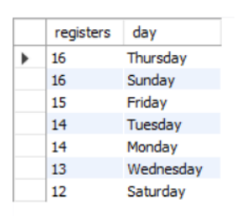
5. Ad Campaign Launch: The team wants to know the best day of the week to launch ads.
Your Task: Determine the day of the week when most users register on Instagram. Provide insights on when to schedule an ad campaign.
Code:
select count(username) as registers , date_format((created_at), '%W') as 'day’ from users group by 2 order by 1 desc;
Output:

Slide 19
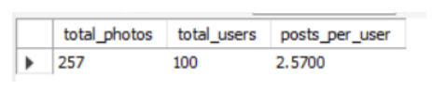
B) Investor Metrics: 1. User Engagement: Investors want to know if users are still active and posting on Instagram or if they are making fewer posts.
Your Task: Calculate the average number of posts per user on Instagram. Also, provide the total number of photos on Instagram divided by the total number of users.
Code: with abcd as (select users.id as u_id, count(photos.id) as p_id from users left join photos on photos.user_id = users.id group by users.id) select sum(p_id) as total_photos, count(u_id) as total_users, sum(p_id) / count(u_id) as posts_per_user from abcd;
Output:

Slide 20
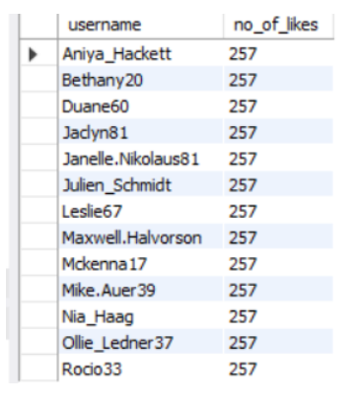
2. Bots & Fake Accounts: Investors want to know if the platform is crowded with fake and dummy accounts.
Your Task: Identify users (potential bots) who have liked every single photo on the site, as this is not typically possible for a normal user.
Code: with abc as (select users.username, count(likes.photo_id) as no_of_likes from likes inner join users on users.id = likes.user_id group by username) select username, no_of_likes from abc where no_of_likes = (select count(*) from photos) order by username;
Output:

Slide 21
Analysis
A) Marketing Analysis:
Top 5 oldest users are :-
Out of 100 users, 26 are inactive and have never posted any content on Instagram, whether it’s a photo, video, or text. Therefore, the Instagram marketing team needs to send reminders to these inactive users.
Winner is Zack_Kemmer93 with 48 likes on photo_id 145
The top 5 most commonly used #hashtags along with the total count are smile(59), beach(42), party(39), fun(38) and concert(24).
According to the data, scheduling an ad campaign on Sunday and Thursday would be beneficial.

Slide 22
B) Investor Metrics:
There are in total 257 rows i.e. 257 photos in the photos table and 100 rows i.e. 100 ids in the users table which makes the desired output to be 257/100 = 2.57 (avg. users posts on Instagram).
Out of the total user id's there are 13 such user id's who have liked each and every post on Instagram (which is not practically possible) and so such user id's are considered as BOTS and Fake Accounts

Slide 23
Conclusion
The project allowed me to transform raw Instagram user data into actionable insights. I successfully extracted, sorted, and visualized data to understand user engagement patterns. This experience honed my SQL skills and reinforced the critical role of data analytics in improving platform efficiency and user experience. The insights derived from the analysis highlighted key areas for potential growth and optimization, making the project both an educational and impactful experience.

Slide 24
3. Operation Analytics and Investigating Metric Spike
Description
This project aims to improve operational efficiency by analyzing data to identify improvement areas. As Lead Data Analyst, I will use SQL to explore metric spikes and evaluate performance. The goal is to deliver actionable insights for optimizing operations and supporting data-driven decisions.
In this project, I started by understanding the company’s objectives and data. I identified key metrics for analysis and used SQL to explore areas like jobs reviewed per hour and user engagement. I refined my queries iteratively, focusing on detecting patterns and anomalies. Finally, I compiled my findings into a report with insights and recommendations to enhance operational efficiency.
MySQL WorkBench v8.0.40 was utilized as part of the tech stack, proving to be an excellent tool for database querying due to its easy access, simple configuration, intuitive graphical user interface, and effective troubleshooting support.

Slide 25
The Problem
Case Study 1: Job Data Analysis
1. Jobs Reviewed Over Time:
Objective: Calculate the number of jobs reviewed per hour for each day in November 2020.
Your Task: Write an SQL query to calculate the number of jobs reviewed per hour for each day in November 2020.
2. Throughput Analysis:
Objective: Calculate the 7-day rolling average of throughput (number of events per second).
Your Task: Write an SQL query to calculate the 7-day rolling average of throughput. Additionally, explain whether you prefer using the daily metric or the 7-day rolling average for throughput, and why.
3. Language Share Analysis:
Objective: Calculate the percentage share of each language in the last 30 days.
Your Task: Write an SQL query to calculate the percentage share of each language over the last 30 days.
4. Duplicate Rows Detection:
Objective: Identify duplicate rows in the data.
Your Task: Write an SQL query to display duplicate rows from the job_data table.

Slide 26
Case Study 2: Investigating Metric Spike
1. Weekly User Engagement:
Objective: Measure the activeness of users on a weekly basis.
Your Task: Write an SQL query to calculate the weekly user engagement.
2. User Growth Analysis:
Objective: Analyze the growth of users over time for a product.
Your Task: Write an SQL query to calculate the user growth for the product.
3. Weekly Retention Analysis:
Objective: Analyze the retention of users on a weekly basis after signing up for a product.
Your Task: Write an SQL query to calculate the weekly retention of users based on their sign-up cohort.
4. Weekly Engagement Per Device:
Objective: Measure the activeness of users on a weekly basis per device.
Your Task: Write an SQL query to calculate the weekly engagement per device.
5. Email Engagement Analysis:
Objective: Analyze how users are engaging with the email service.
Your Task: Write an SQL query to calculate the email engagement metrics.

Slide 27
Design
Steps followed to load the data into the database:
- A new database was created using the CREATE DATABASE function in MySQL.
- Tables and column names were defined and added.
- Data was inserted into the tables using the INSERT INTO command.
- The SELECT command can be used to query and retrieve the desired output.

Slide 28
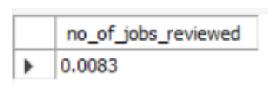
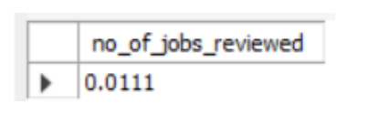
Findings
Case Study 1: Job Data Analysis
1. Jobs Reviewed Over Time:
○ Objective: Calculate the number of jobs reviewed per hour for each day in November 2020.
○ Task: Write an SQL query to calculate the number of jobs reviewed per hour for each day in November 2020.
Code (distinct): select count(distinct job_id)/(30*24) as no_of_jobs_reviewed from job_data;
Output:
Code (non-distinct) : select count(job_id)/(30*24) as no_of_jobs_reviewed from job_data;
Output:

Slide 29
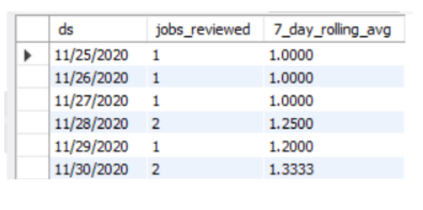
2. Throughput Analysis:
○ Objective: Calculate the 7-day rolling average of throughput (number of events per second).
○ Task: Write an SQL query to calculate the 7-day rolling average of throughput. Additionally, explain whether you prefer using the daily metric or the 7-day rolling average for throughput, and why.
Code: select ds, count(distinct job_id) as jobs_reviewed, avg(count(distinct job_id)) OVER (ORDER BY ds ROWS BETWEEN 6 PRECEDING AND CURRENT ROW) as 7_day_rolling_avg from job_data group by ds order by ds;
Output:

Slide 30
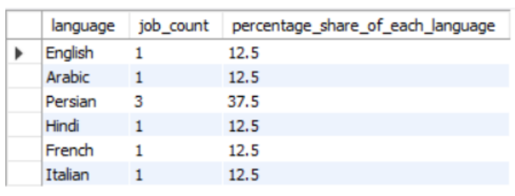
3. Language Share Analysis:
○ Objective: Calculate the percentage share of each language in the last 30 days.
○ Task: Write an SQL query to calculate the percentage share of each language over the last 30 days.
Code: select language, COUNT(*) AS job_count, ROUND((COUNT(*) * 100.0 / SUM(COUNT(*)) over ()), 1) as percentage_share_of_each_language from job_data group by language;
Output:

Slide 31
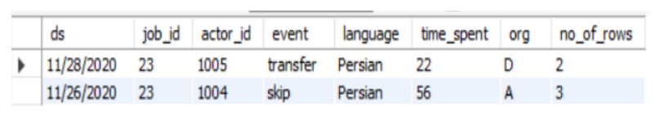
4. Duplicate Rows Detection:
○ Objective: Identify duplicate rows in the data.
○ Task: Write an SQL query to display duplicate rows from the job_data table.
Code: select * from (select *, row_number() over (partition by job_id) as no_of_rows from job_data) e where no_of_rows>1;
Output:

Slide 32
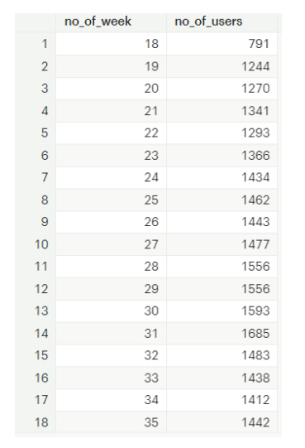
Case Study 2: Investigating Metric Spike
Weekly User Engagement:
○ Objective: Measure the activeness of users on a weekly basis.
○ Task: Write an SQL query to calculate the weekly user engagement.
Code: select extract(week from occurred_at) as no_of_week, count(distinct user_id) as no_of_users from events group by no_of_week;
Output:

Slide 33
2. User Growth Analysis:
○ Objective: Analyze the growth of users over time for a product.
○ Task: Write an SQL query to calculate the user growth for the product.
Code: select year,week,no_of_active_users, SUM(no_of_active_users)OVER(ORDER BY year, week ROWS BETWEEN UNBOUNDED PRECEDING AND CURRENT ROW) AS total_active_users from ( select extract (year from a.activated_at) as year, extract (week from a.activated_at) as week, count(distinct user_id) as no_of_active_users from users a WHERE state = 'active’ group by year,week order by year,week ) a;

Slide 34
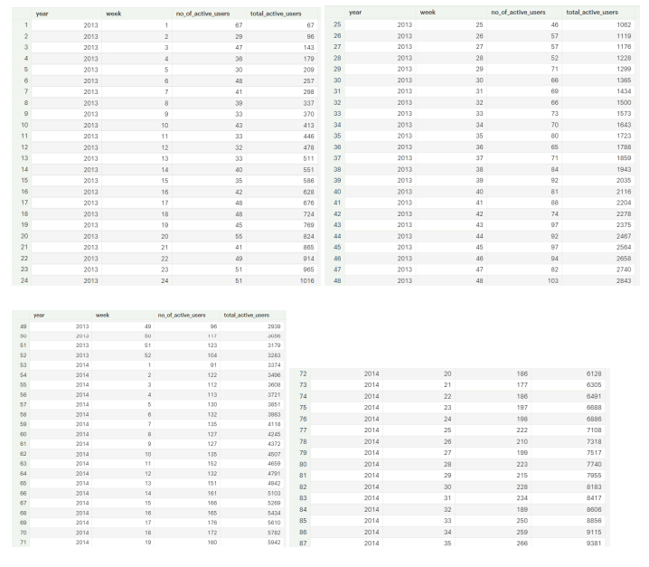
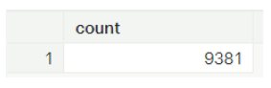
Output:
Code (counting users from user table having state as active): select count(*) from users where state = 'active’;
Output:

Slide 35
3. Weekly Retention Analysis:
○ Objective: Analyze the retention of users on a weekly basis after signing up for a product.
○ Task: Write an SQL query to calculate the weekly retention of users based on their sign-up cohort.
Code: SELECT distinct user_id, COUNT(user_id), SUM(CASE WHEN retention_week = 1 Then 1 Else 0 END) as per_week_retention FROM ( SELECT a.user_id, a.signup_week, b.engagement_week, b.engagement_week - a.signup_week as retention_week FROM ( (SELECT distinct user_id, extract(week from occurred_at) as signup_week from events WHERE event_type = 'signup_flow’ and event_name = 'complete_signup') a LEFT JOIN (SELECT distinct user_id, extract (week from occurred_at) as engagement_week FROM events where event_type = 'engagement') b on a.user_id = b.user_id)) d group by user_id order by user_id;

Slide 36
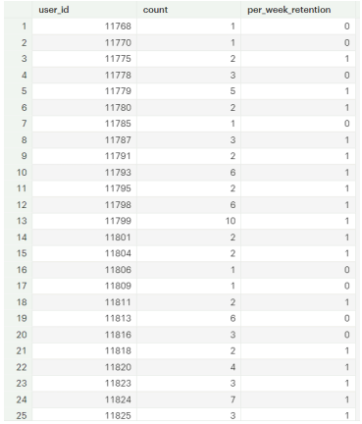
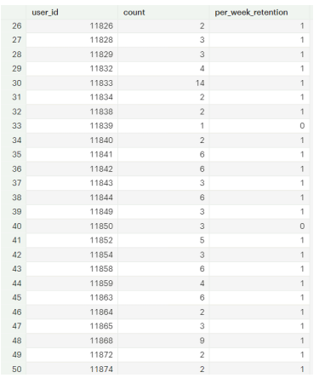
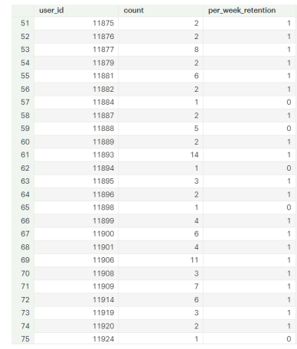
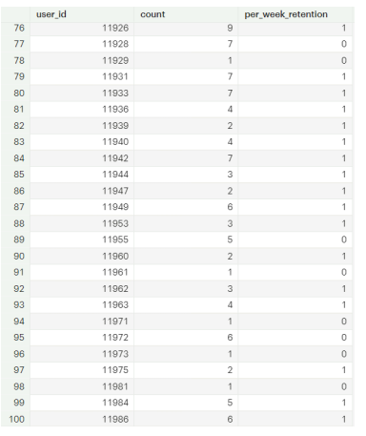
Output (first 100):
Full Output Drive Link: without week 18 (weekly retention)

Slide 37
Code (Specifying week number as 18): SELECT distinct user_id, COUNT(user_id), SUM(CASE WHEN retention_week = 1 Then 1 Else 0 END) as per_week_retention FROM ( SELECT a.user_id, a.signup_week, b.engagement_week, b.engagement_week - a.signup_week as retention_week FROM ( (SELECT distinct user_id, extract(week from occurred_at) as signup_week from events WHERE event_type = 'signup_flow’ and event_name = 'complete_signup’ and extract(week from occurred_at) = 18) a LEFT JOIN (SELECT distinct user_id, extract (week from occurred_at) as engagement_week FROM events where event_type = 'engagement') b on a.user_id = b.user_id) ) d group by user_id order by user_id;
Full Output Drive Link: week 18 (weekly retention)

Slide 38
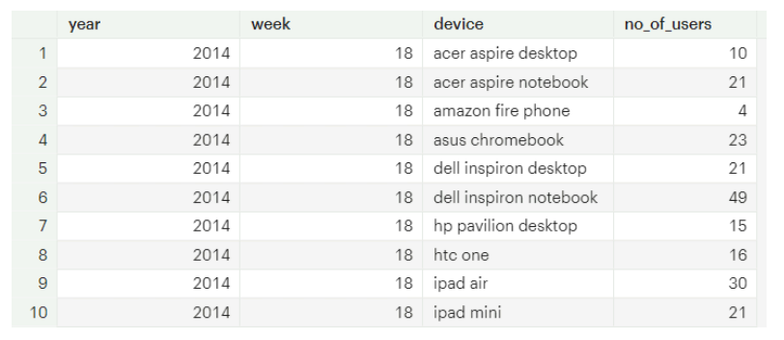
4. Weekly Engagement Per Device:
○ Objective: Measure the activeness of users on a weekly basis per device.
○ Task: Write an SQL query to calculate the weekly engagement per device.
Code: SELECT extract(year from occurred_at) as year, extract(week from occurred_at) as week, device, COUNT(distinct user_id) as no_of_users FROM events where event_type = 'engagement’ GROUP by 1,2,3 order by 1,2,3; Output (first 10):
Full Output Drive Link: weekly engagement

Slide 39
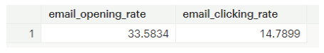
5. Email Engagement Analysis:
○ Objective: Analyze how users are engaging with the email service.
○ Task: Write an SQL query to calculate the email engagement metrics.
Code: SELECT 100.0*SUM(CASE when email_cat = 'email_opened' then 1 else 0 end)/SUM(CASE when email_cat = 'email_sent' then 1 else 0 end) as email_opening_rate, 100.0*SUM(CASE when email_cat = 'email_clicked' then 1 else 0 end)/SUM(CASE when email_cat = 'email_sent' then 1 else 0 end) as email_clicking_rate FROM (SELECT *, CASE WHEN action in ('sent_weekly_digest','sent_reengagement_email') then 'email_sent’ WHEN action in ('email_open’) then 'email_opened’ WHEN action in ('email_clickthrough’) then 'email_clicked’ end as email_cat from email_events ) a;
Output:

Slide 40
Analysis
Case Study 1: Job Data Analysis
1. Number of distinct job reviewed per day is 0.0083
Number of non-distinct jobs reviewed per day is 0.0111
2. 7 day rolling average throughput for 25, 26, 27, 28, 29 and 30 Nov 2020 are 1, 1, 1, 1.25, 1.2 and 1.3333 respectively(for both distinct and non-distinct)
3. Percentage Share of each language i.e. Arabic, English, French, Hindi, Italian and Persian are 12.5, 12.5, 12.5, 12.5, 12.5 and 37.5 respectively(for both distinct and nondistinct)
4. There are 2 duplicates values/rows having job_id = 23 and language = Persian in both the rows

Slide 41
Case Study 2: Investigating Metric Spike
1. The weekly user engagement is the highest for week 31 i.e. 1685
2. There are in total 9381 active users from 1st week of 2013 to the 35th week of 2014
3. The email_opening_rate is 33.5833 and email_clicking_rate is 14.78988

Slide 42
Conclusion
Through this project, I was able to identify key operational improvements and gain a deeper understanding of the company’s performance metrics. By using advanced SQL, I uncovered patterns and anomalies, which enhanced my decision-making abilities. This experience not only sharpened my analytical skills but also reinforced the importance of data-driven strategies in optimizing operations.

Slide 43
4. Hiring Process Analytics
Description
This project aims to analyze a multinational company's hiring data to uncover insights that can enhance the hiring process. The objectives include understanding gender distribution among hires, analyzing salary patterns, and visualizing departmental and positional distributions. The approach involves cleaning the data by handling missing values and outliers, simplifying categories, and then performing statistical analysis and visualization using Excel to draw meaningful conclusions about the company's hiring trends. I cleaned the dataset by handling missing data and outliers using Excel functions like COUNTIF(), QUARTILE(), and IF(). I analyzed gender distribution, average salary, and departmental roles, creating class intervals for salary ranges. Finally, I visualized key insights using bar charts, pie charts, and histograms to effectively communicate findings. I used Microsoft Excel 2021 for this project. Excel was chosen for its robust data manipulation, statistical analysis, and visualization capabilities. It enabled me to clean and analyze the hiring data, calculate key metrics like average salary, and create visual representations such as bar charts and pie charts to effectively communicate insights.

Slide 44
The Problem
A. Hiring Analysis: The hiring process involves bringing new individuals into the organization for various roles.
Your Task: Determine the gender distribution of hires. How many males and females have been hired by the company?
B. Salary Analysis: The average salary is calculated by adding up the salaries of a group of employees and then dividing the total by the number of employees.
Your Task: What is the average salary offered by this company? Use Excel functions to calculate this.
C. Salary Distribution: Class intervals represent ranges of values, in this case, salary ranges. The class interval is the difference between the upper and lower limits of a class.
Your Task: Create class intervals for the salaries in the company. This will help you understand the salary distribution.
D. Departmental Analysis: Visualizing data through charts and plots is a crucial part of data analysis.
Your Task: Use a pie chart, bar graph, or any other suitable visualization to show the proportion of people working in different departments.
E. Position Tier Analysis: Different positions within a company often have different tiers or levels.
Your Task: Use a chart or graph to represent the different position tiers within the company. This will help you understand the distribution of positions across different tiers.

Slide 45
Design
First, I created a copy of the raw data to perform the analysis, ensuring that any changes made wouldn’t affect the original dataset.
Next, I checked for any blank spaces and NULL values.
For numerical blank or NULL cells, I imputed values based on the column’s mean (if no outliers were present) or the median (if outliers existed).
I then identified any outliers and replaced them with the median value of the respective column.
For blank cells in categorical variables, I filled them with the most frequent category.
I also checked for and removed any duplicate rows.
Finally, I eliminated irrelevant columns that were unnecessary for the analysis.

Slide 46
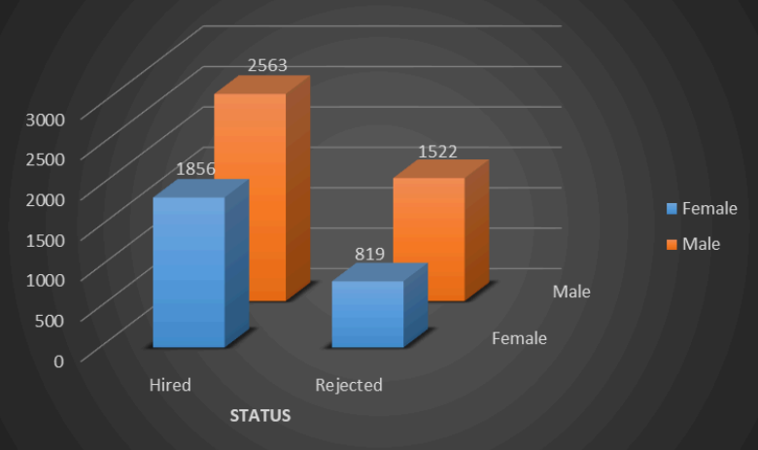
Findings
A. Hiring Analysis: The hiring process involves bringing new individuals into the organization for various roles. Task: Determine the gender distribution of hires. How many males and females have been hired by the company?

Slide 47
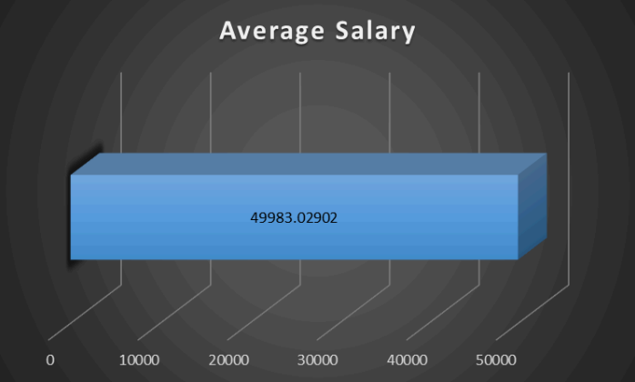
B. Salary Analysis: The average salary is calculated by adding up the salaries of a group of employees and then dividing the total by the number of employees. Task: What is the average salary offered by this company? Use Excel functions to calculate this.
To find the average salary offered by the company we have to use this formula: =AVERAGE(G:G) which is 49983.03

Slide 48
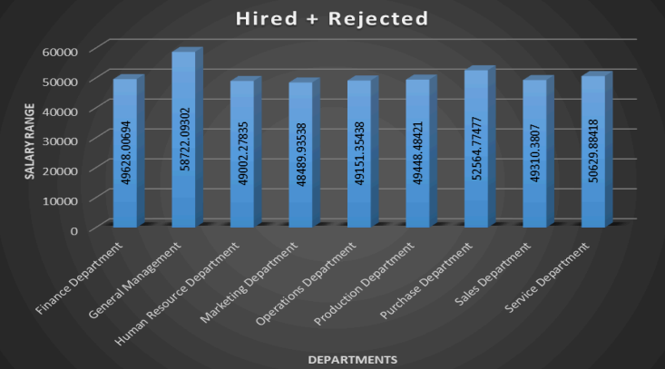
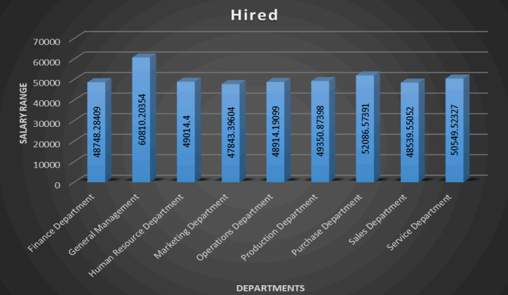
C. Salary Distribution: Class intervals represent ranges of values, in this case, salary ranges. The class interval is the difference between the upper and lower limits of a class. Task: Create class intervals for the salaries in the company. This will help you understand the salary distribution.

Slide 49
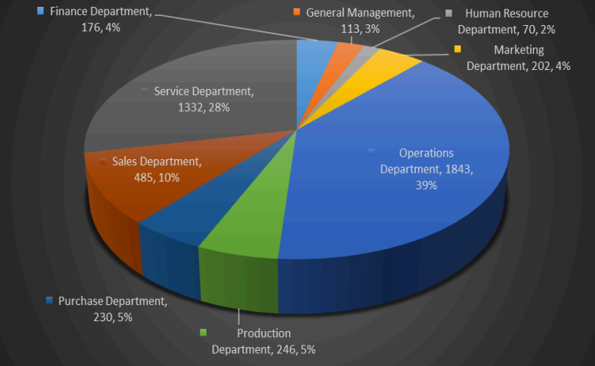
D. Departmental Analysis: Visualizing data through charts and plots is a crucial part of data analysis. Task: Use a pie chart, bar graph, or any other suitable visualization to show the proportion of people working in different departments.

Slide 50
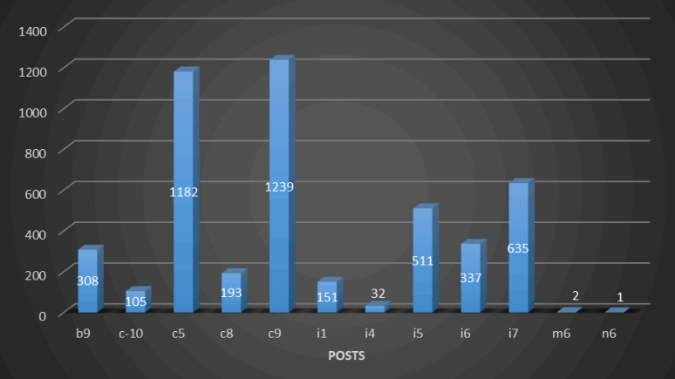
E. Position Tier Analysis: Different positions within a company often have different tiers or levels. Task: Use a chart or graph to represent the different position tiers within the company. This will help you understand the distribution of positions across different tiers.

Slide 51
Analysis
1. There are 2563 Males hired for different roles in the company While there are only 1855 Females hired for different roles in the company.
2. The average salary offered by this company is 49983.03.
3. The highest number of salary is offered in General Management with around 58722.1 (for both hired + rejected). The highest number of salary is offered in General Management with around 60810.2 (for hired).
4. The Highest number of people were working in the Operations Department i.e. 1843 which accounts for almost 39% of the total workforce of the company.
5. the c9 post has the highest number of openings i.e. 1239 which accounts for 25% of the total job openings of the company/firm

Slide 52
Conclusion
Through this project, I successfully analyzed the company's hiring data to uncover critical insights such as gender distribution, average salary, and departmental hiring patterns. By cleaning the data, handling outliers, and creating meaningful visualizations, I gained a deeper understanding of how data analytics can reveal trends and inefficiencies in the hiring process. This analysis not only highlighted the importance of data-driven decision-making but also demonstrated how such insights can help optimize recruitment strategies and improve overall organizational efficiency.

Slide 53
5. IMDB Movie Analysis
Description
This project explores the factors that contribute to a movie's success on IMDB, with success defined by achieving high ratings. By analyzing various aspects of movies such as genre, duration, language, director, and budget, the project aims to uncover patterns and relationships that influence audience ratings. The insights gained from this analysis can help movie producers, directors, and investors understand which elements are most likely to lead to successful films, allowing them to make more informed decisions in future projects. The project combines data cleaning, statistical analysis, and visualization techniques to provide a comprehensive understanding of the factors driving movie success on IMDB.
I started by cleaning the IMDB Movies dataset, handling missing values, removing duplicates, and ensuring data consistency. For the analysis, I used Excel to calculate descriptive statistics (mean, median, variance) and performed correlation analysis between key variables like genre, duration, language, director, and budget with IMDB ratings.
Microsoft Excel 2021: Utilized for data cleaning, statistical analysis, and visualization. Excel was used to calculate descriptive statistics, perform correlation analysis, create various charts (e.g., bar charts, scatter plots), and compile the final report with visual aids. Excel’s powerful functions and tools made it the ideal software for analyzing and presenting the IMDB Movies dataset effectively.

Slide 54
The Problem
A. Movie Genre Analysis: Analyze the distribution of movie genres and their impact on the IMDB score.
Task: Determine the most common genres of movies in the dataset. Then, for each genre, calculate descriptive statistics (mean, median, mode, range, variance, standard deviation) of the IMDB scores.
B. Movie Duration Analysis: Analyze the distribution of movie durations and its impact on the IMDB score.
Task: Analyze the distribution of movie durations and identify the relationship between movie duration and IMDB score.
C. Language Analysis: Situation: Examine the distribution of movies based on their language.
Task: Determine the most common languages used in movies and analyze their impact on the IMDB score using descriptive statistics.
D. Director Analysis: Influence of directors on movie ratings.
Task: Identify the top directors based on their average IMDB score and analyze their contribution to the success of movies using percentile calculations.
E. Budget Analysis: Explore the relationship between movie budgets and their financial success.
Task: Analyze the correlation between movie budgets and gross earnings, and identify the movies with the highest profit margin.

Slide 55
Design
1. First, I made a copy of the raw data to work on, ensuring that any changes made would not affect the original dataset.
2. Next, I dropped columns that were unnecessary for the analysis.
3. Columns like 'Color', 'director_facebook_likes', 'actor_3_facebook_likes', 'actor_2_name', 'actor_1_facebook_likes', 'cast_total_facebook_likes', 'actor_3_name', 'facenumber_in_posts', 'plot_keywords', 'movie_imdb_link', 'content_rating', 'actor_2_facebook_likes', 'aspect_ratio', and 'movie_facebook_likes' were deemed irrelevant and removed.
4. After removing irrelevant columns, I eliminated any rows with blank or NULL values in any column.
5. Lastly, I removed any duplicate values from the dataset using the 'Remove Duplicate Values' option in the 'Data' tab.

Slide 56
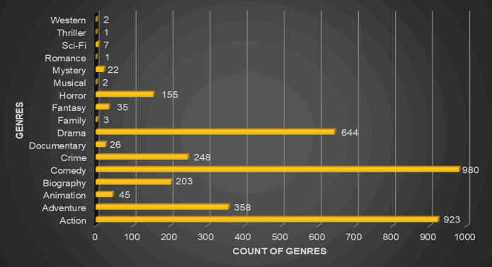
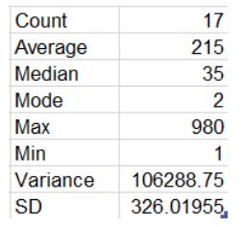
Findings
A. Movie Genre Analysis: Analyze the distribution of movie genres and their impact on the IMDB score.
Task: Determine the most common genres of movies in the dataset. Then, for each genre, calculate descriptive statistics (mean, median, mode, range, variance, standard deviation) of the IMDB scores.

Slide 57
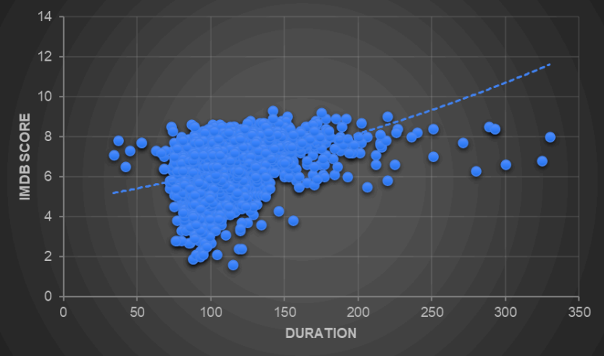
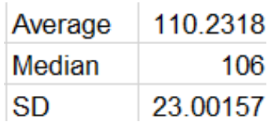
B. Movie Duration Analysis: Analyze the distribution of movie durations and its impact on the IMDB score.
Task: Analyze the distribution of movie durations and identify the relationship between movie duration and IMDB score

Slide 58
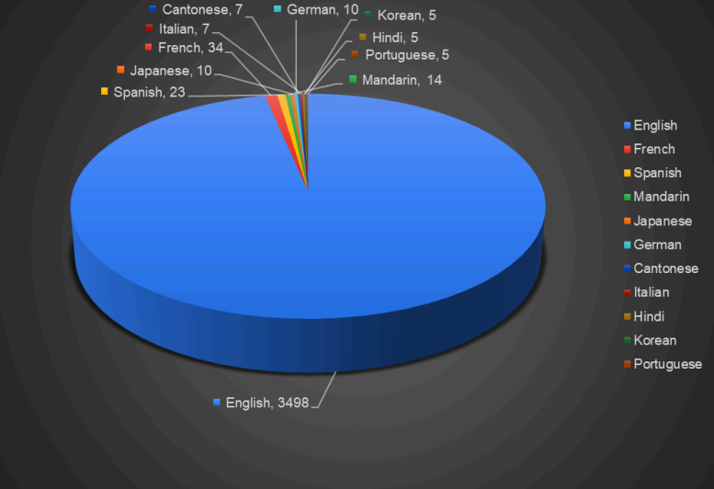
C. Language Analysis: Situation: Examine the distribution of movies based on their language.
Task: Determine the most common languages used in movies and analyze their impact on the IMDB score using descriptive statistics.

Slide 59
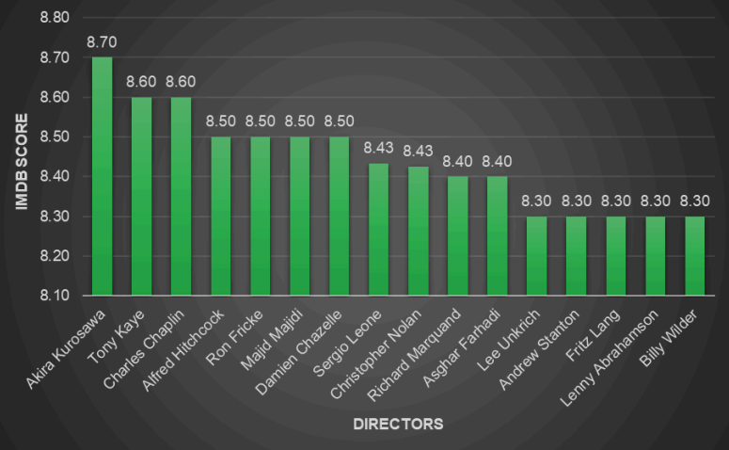
D. Director Analysis: Influence of directors on movie ratings.
Task: Identify the top directors based on their average IMDB score and analyze their contribution to the success of movies using percentile calculations.

Slide 60
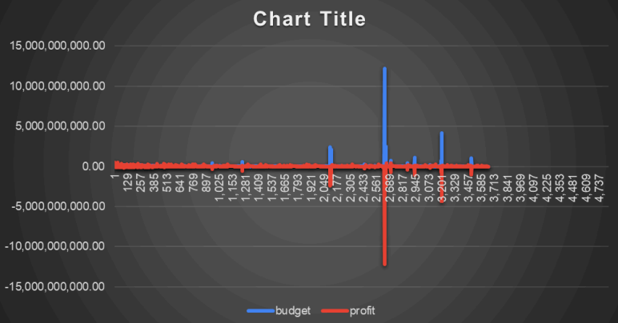
E. Budget Analysis: Explore the relationship between movie budgets and their financial success.
Task: Analyze the correlation between movie budgets and gross earnings, and identify the movies with the highest profit margin.

Slide 61
Analysis
1. According to the data, ‘Comedy ’genre is most common among other movies in the dataset. Followed by ‘Action’ then ‘Drama’.
2. Most of the movies between 90 min to 160 min with IMBD score of around 4 to 8.
3. English is the most common language across all movies with 3498 movies.
4. Directors like Akira Kurosawa, Tony Kayne, Charles Chaplin, etc have more scores on imdb.
5. The movie with the highest profit margin is ‘Avatar’.

Slide 62
Conclusion
Through this project, I gained a deep understanding of what influences IMDB movie ratings. By analyzing genre, duration, language, director, and budget, I identified key factors that correlate with higher ratings and financial success. The insights revealed which genres and directors are linked to better ratings, how movie length impacts success, and the role of language and budget in financial performance. This analysis provides actionable guidance for movie industry professionals and enhances my skills in data analysis, allowing for more informed decision-making and strategic planning.

Slide 63
6. Bank Loan Case Study
Description
This project aims to analyze loan application data using Exploratory Data Analysis (EDA) to identify factors influencing loan default. The objective is to understand patterns that differentiate reliable borrowers from those at risk of default. By handling missing data, identifying outliers, analyzing data imbalance, and exploring correlations between variables, the project helps improve loan approval decisions and reduce financial risk. The approach leverages Excel functions for statistical analysis and visualizations to gain insights into customer and loan attributes.
My approach involved cleaning the data by identifying and imputing missing values, detecting outliers using the Interquartile Range (IQR), and analyzing data imbalance with `COUNTIF`. I performed univariate, segmented, and bivariate analysis using Excel’s statistical functions and pivot tables. Correlation analysis was conducted with `CORREL` to identify key indicators of loan default, and visual insights were presented through charts like bar, pie, scatter plots, and heatmaps. This method provided a comprehensive understanding of the factors influencing loan defaults.
I utilized Microsoft Excel 2021 for data cleaning, analysis, and visualization. Additionally, pivot tables were used for segmented analysis, and various visualizations like bar charts, pie charts, and scatter plots were created to effectively present insights and patterns in the data.

Slide 64
The Problem
A. Identify Missing Data and Deal with it Appropriately: As a data analyst, you come across missing data in the loan application dataset. It is essential to handle missing data effectively to ensure the accuracy of the analysis.
Task: Identify the missing data in the dataset and decide on an appropriate method to deal with it using Excel built-in functions and features.
B. Identify Outliers in the Dataset: Outliers can significantly impact the analysis and distort the results. You need to identify outliers in the loan application dataset.
Task: Detect and identify outliers in the dataset using Excel statistical functions and features, focusing on numerical variables.
C. Analyze Data Imbalance: Data imbalance can affect the accuracy of the analysis, especially for binary classification problems. Understanding the data distribution is crucial for building reliable models.
Task: Determine if there is data imbalance in the loan application dataset and calculate the ratio of data imbalance using Excel functions.
D. Perform Univariate, Segmented Univariate, and Bivariate Analysis: To gain insights into the driving factors of loan default, it is important to conduct various analyses on consumer and loan attributes.
Task: Perform univariate analysis to understand the distribution of individual variables, segmented univariate analysis to compare variable distributions for different scenarios, and bivariate analysis to explore relationships between variables and the target variable using Excel functions and features.
E. Identify Top Correlations for Different Scenarios: Understanding the correlation between variables and the target variable can provide insights into strong indicators of loan default.
Task: Segment the dataset based on different scenarios (e.g., clients with payment difficulties and all other cases) and identify the top correlations for each segmented data using Excel functions.

Slide 65
Design
First, I made a copy of the raw loan application dataset to ensure that any analysis performed wouldn’t impact the original data.
Next, I began by checking for missing data, utilizing functions to identify blank spaces and NULL values. For numerical variables, I assessed the presence of any blanks or NULL cells and decided to impute these values using the mean if the data distribution appeared normal or the median if outliers were present.
I then focused on identifying outliers in the dataset, applying statistical methods to detect any values that fell outside acceptable thresholds. For those identified as outliers, I replaced them with the median value of their respective columns to maintain the dataset's integrity.
For categorical variables with missing values, I filled in blanks with the most frequent category, ensuring that the data remained representative. I also conducted a thorough check for duplicate entries and removed any rows that were exact copies to avoid skewing the analysis results.
Finally, I reviewed the dataset for irrelevant columns that did not contribute to the analysis and eliminated them, streamlining the dataset for further exploratory analysis. This structured approach set the foundation for a robust EDA process to identify patterns associated with loan defaults.

Slide 66
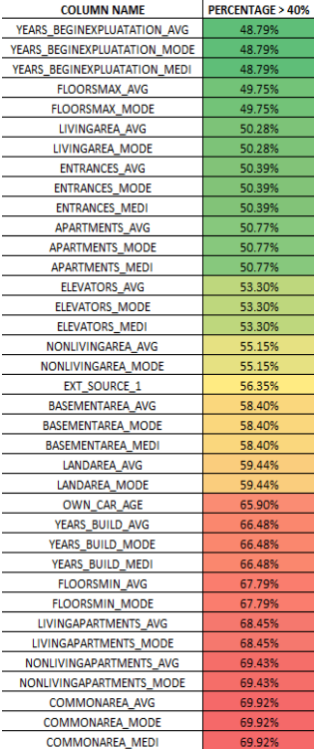
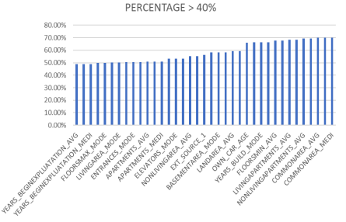
Findings
A. Identify Missing Data and Deal with it Appropriately: As a data analyst, you come across missing data in the loan application dataset. It is essential to handle missing data effectively to ensure the accuracy of the analysis. ● Task: Identify the missing data in the dataset and decide on an appropriate method to deal with it using Excel built-in functions and features.
Part 1: Null Values :- These are the columns which have null values more than or equal to 40%.

Slide 67
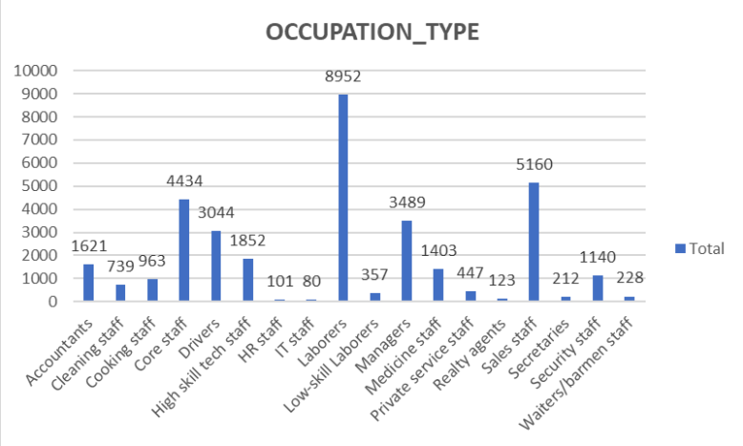
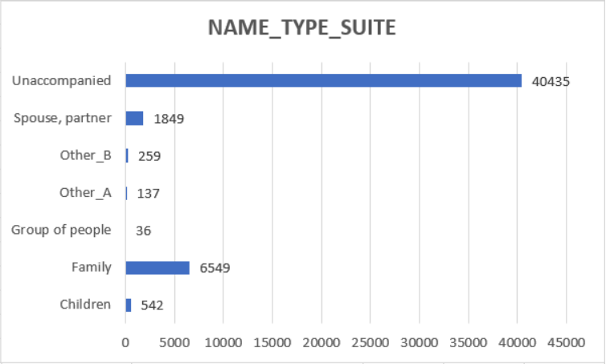
Part 2: Mode Imputation :-

Slide 68
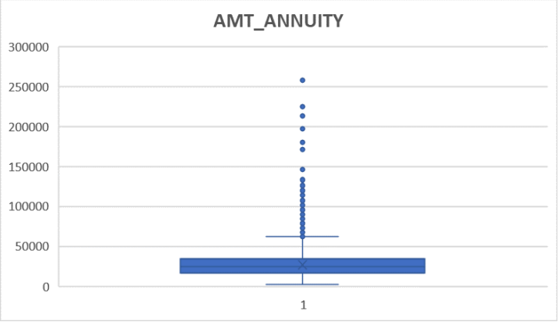
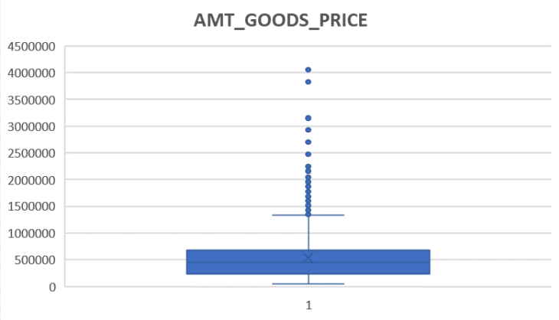
Part 3 : Median Imputation :-

Slide 69
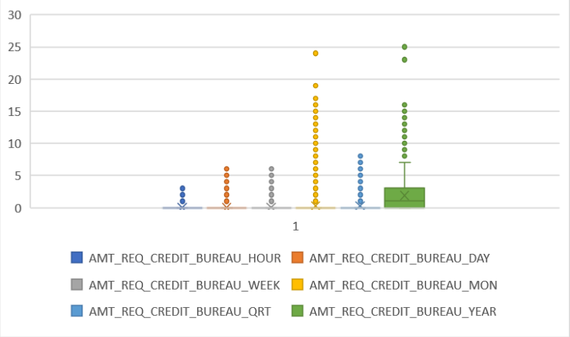
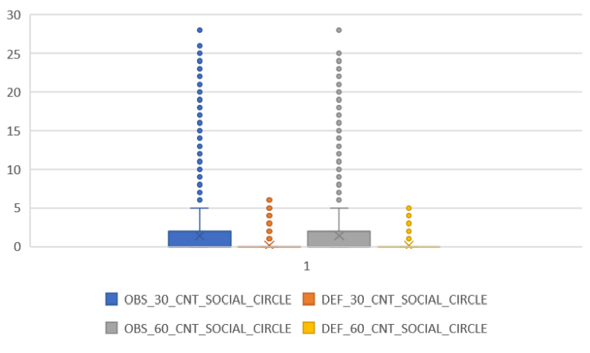

Slide 70
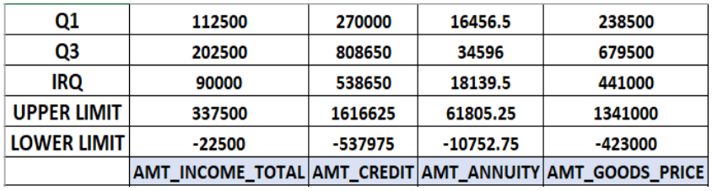
B. Identify Outliers in the Dataset: Outliers can significantly impact the analysis and distort the results. You need to identify outliers in the loan application dataset. ● Task: Detect and identify outliers in the dataset using Excel statistical functions and features, focusing on numerical variables.
Part 1:
Formulas:-
Quartile 1 : =QUARTILE.EXC(“range”,1 ) Quartile 3 : =QUARTILE.EXC(“range”,3) IQR = Quartile 3 - Quartile 1 Upper Limit = Quartile 3 + 1.5*IQR Lower Limit = Quartile 1 – 1.5IQR

Slide 71
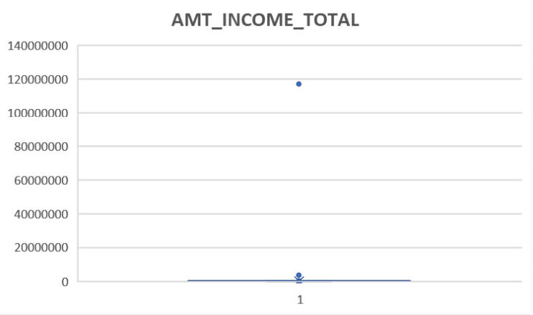
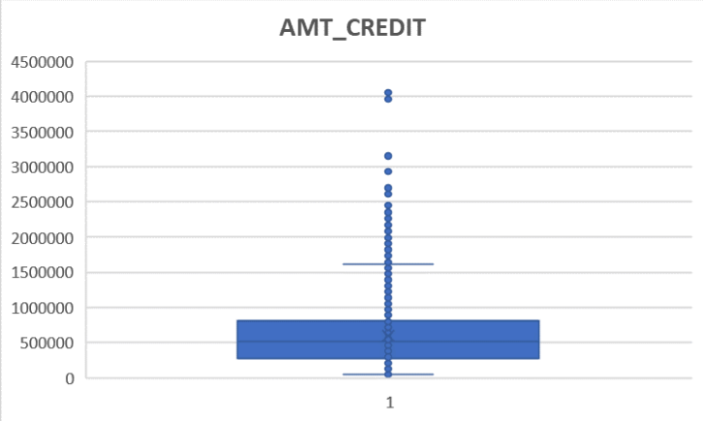

Slide 72
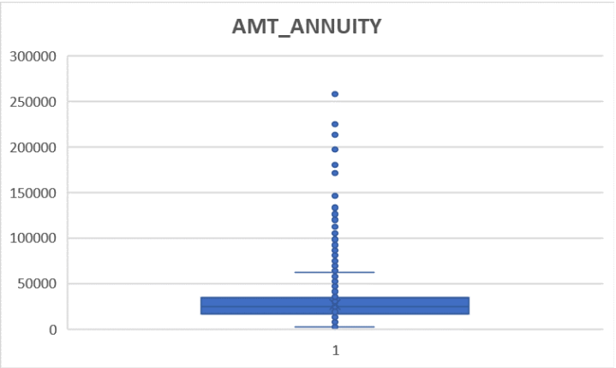


Slide 73
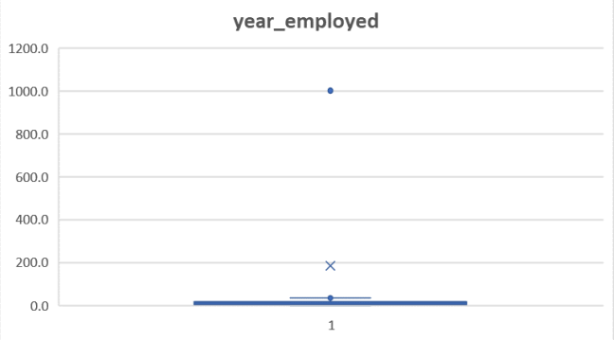
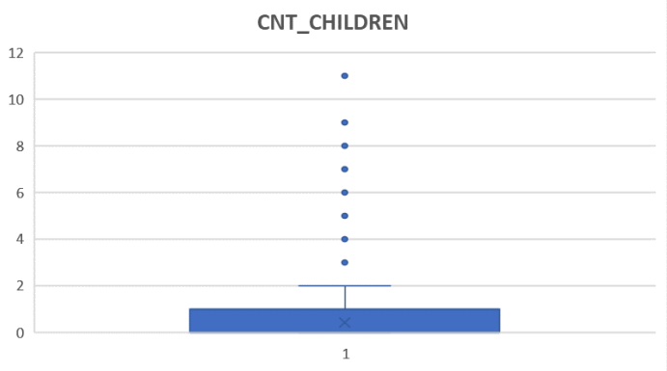
Part 2:

Slide 74
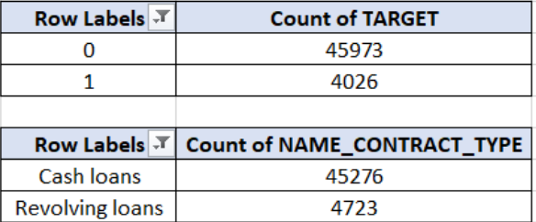

C. Analyze Data Imbalance: Data imbalance can affect the accuracy of the analysis, especially for binary classification problems. Understanding the data distribution is crucial for building reliable models.
Task: Determine if there is data imbalance in the loan application dataset and calculate the ratio of data imbalance using Excel functions.

Slide 75



Slide 76

D. Perform Univariate, Segmented Univariate, and Bivariate Analysis: To gain insights into the driving factors of loan default, it is important to conduct various analyses on consumer and loan attributes.
Task: Perform univariate analysis to understand the distribution of individual variables, segmented univariate analysis to compare variable distributions for different scenarios, and bivariate analysis to explore relationships between variables and the target variable using Excel functions and features.
Univariate:
1.

Slide 77



Slide 78



2.

Slide 79



3.

Slide 80


4.

Slide 81





Slide 82



Segmented Univariate:
1.

Slide 83



2.

Slide 84



3.

Slide 85


Bivariate:
1.

Slide 86



Slide 87


2.

Slide 88



Slide 89

E. Identify Top Correlations for Different Scenarios: Understanding the correlation between variables and the target variable can provide insights into strong indicators of loan default.
Task: Segment the dataset based on different scenarios (e.g., clients with payment difficulties and all other cases) and identify the top correlations for each segmented data using Excel functions.
● 1 indicates a perfect positive correlation, ● -1 indicates a perfect negative correlation, ● 0 means no correlation.
Target 0, Non Defaulter:

Slide 90

Target 1, Defaulter:

Slide 91
Analysis
A. Most occurring variable is “Laborers" with a count of 8952. Most occurring variable is “Unaccompanied” with a count of 40435.
B. In column “year_employed” we can see people being employed for 1001 yrs which is not possible. Column “CNT_CHILDREN” shows people are having 11 children which is impossible in today’s age.
C. Almost 92% of clients repay loans on time. Whereas, 8% of clients are defaulters. 91% of clients applied for cash loans. And, 9% applied for revolving loans.
D. We can observe that most clients who took the loan are married, then followed by single and so on. Also, most clients who repay their loans on time are married then followed by singles. This analysis shows that those who have 0 - 2 children are likely to take out loans. Similarly, clients having 0 - 2 children repay their loans on time. Clients having 0 - 2 members in their family are likely to take out loans. Similarly, clients with 0 - 2 members in their family repay loans on time followed by clients with 3 - 5 members. More females are likely to take loans compared to male. 66% female and 34% male.

Slide 92
In both cases females lead because they took out more loans compared to male. Here we can observe that most of the clients (male and female) paid their loans on time. Most clients having income of 100,000 - 199,999 are likely to take out loans followed by the income range of 200,000 - 299,999 and 0 - 99,999. In most cases we can observe that 80% - 90% of times clients are repaying their loans on time. Clients having credit range from 200,000 - 299,999 have taken more loans followed by clients with credit range of more than 1,000,000. Similarly, the same credit ranges lead here. With most of them being non defaulters. Annuity range of 0 - 49,999 have most clients with the count of 46561. And the least count is of 1 with an annuity more than 250,000. Majority of the clients repay their loans on time. Majority of the clients are from the age range of 30 - 39 then closely followed by 40 - 49 and 50 - 59, with the least number of clients from the age range of more than or equal to 60. Age group of 40 - 49 have the most amount credited. Least is 20 - 29. All age groups are likely to repay their loans on time. Highest being 30 - 39. Most applicants are Working with 52%. The least are Businessman, Maternity Leave, Student and Unemployed. Most amount credited to a client is Businessman. Majority of the clients are non defaulters with most being Working.

Slide 93
Conclusion
Through this project, I successfully identified key factors that influence loan default, such as customer attributes and loan characteristics, by performing Exploratory Data Analysis (EDA). I handled missing data, detected outliers, and addressed data imbalance, which enhanced the accuracy of the analysis. The correlation analysis revealed strong indicators of loan default, helping identify risky applicants. This project deepened my understanding of how data-driven insights can improve decision-making in loan approval, helping banks mitigate financial risks and improve customer targeting.

Slide 94
7. Analyzing the Impact of Car Features on Price and Profitability
Description
This project analyzes the impact of various car features on pricing and profitability to help manufacturers optimize pricing and product development decisions. Using a dataset containing 11,159 car models, the project examines factors like engine power, fuel efficiency, transmission type, and market categories to understand their relationship with car prices. The central aim is to address how manufacturers can maximize profitability while meeting consumer demand. Data cleaning steps included removing duplicates, handling missing values, and standardizing formats. Through regression analysis and visualizations like scatter plots and pivot tables, the project identifies key features that influence price and consumer preferences. The results can guide manufacturers in balancing consumer demand with profitability, helping them stay competitive in a rapidly evolving automotive market.
The project used descriptive statistics and data visualization (scatter plots, bar charts) to explore relationships between key variables like MSRP, horsepower, and fuel efficiency. Regression analysis was applied to identify features most impacting price, and pivot tables were used to calculate averages and distributions

Slide 95
The Problem
Tasks: Analysis
1. How does the popularity of a car model vary across different market categories?
Task 1.A: Create a pivot table that shows the number of car models in each market category and their corresponding popularity scores.
Task 1.B: Create a combo chart that visualizes the relationship between market category and popularity.
2. What is the relationship between a car's engine power and its price?
Task 2: Create a scatter chart that plots engine power on the x-axis and price on the y-axis. Add a trendline to the chart to visualize the relationship between these variables.
3. Which car features are most important in determining a car's price?
Task 3: Use regression analysis to identify the variables that have the strongest relationship with a car's price. Then create a bar chart that shows the coefficient values for each variable to visualize their relative importance.
4. How does the average price of a car vary across different manufacturers?
Task 4.A: Create a pivot table that shows the average price of cars for each manufacturer.
Task 4.B: Create a bar chart or a horizontal stacked bar chart that visualizes the relationship between manufacturer and average price.
5. What is the relationship between fuel efficiency and the number of cylinders in a car's engine?
Task 5.A: Create a scatter plot with the number of cylinders on the x-axis and highway MPG on the y-axis. Then create a trendline on the scatter plot to visually estimate the slope of the relationship and assess its significance.
Task 5.B: Calculate the correlation coefficient between the number of cylinders and highway MPG to quantify the strength and direction of the relationship.

Slide 96
Building the Dashboard:
Task 1: How does the distribution of car prices vary by brand and body style?
Task 2: Which car brands have the highest and lowest average MSRPs, and how does this vary by body style?
Task 3: How do the different feature such as transmission type affect the MSRP, and how does this vary by body style?
Task 4: How does the fuel efficiency of cars vary across different body styles and model years?
Task 5: How does the car's horsepower, MPG, and price vary across different Brands?

Slide 97
Design
1. Firstly, I made a copy of the raw data to ensure that any modifications or changes during the analysis process wouldn’t impact the original dataset.
2. Next, I dropped the columns that were irrelevant and not required for the analysis to streamline the dataset.
3. After removing the unnecessary columns, I checked for rows that had any blank or NULL values and removed those rows from the dataset to ensure data completeness.
4. Finally, I eliminated any duplicate rows in the dataset using the 'Remove Duplicate Values' option in the ‘Data’ tab to ensure that no redundancy existed in the data.

Slide 98

Findings
Analysis:
How does the popularity of a car model vary across different market categories?
Task 1.A: Create a pivot table that shows the number of car models in each market category and their corresponding popularity scores.
Task 1.B: Create a combo chart that visualizes the relationship between market category and popularity.

Slide 99

What is the relationship between a car's engine power and its price?
Task 2: Create a scatter chart that plots engine power on the x-axis and price on the y-axis. Add a trendline to the chart to visualize the relationship between these variables.

Slide 100


Which car features are most important in determining a car's price?
Task 3: Use regression analysis to identify the variables that have the strongest relationship with a car's price. Then create a bar chart that shows the coefficient values for each variable to visualize their relative importance

Slide 101


How does the average price of a car vary across different manufacturers?
Task 4.A: Create a pivot table that shows the average price of cars for each manufacturer.
Task 4.B: Create a bar chart or a horizontal stacked bar chart that visualizes the relationship between manufacturer and average price.

Slide 102


What is the relationship between fuel efficiency and the number of cylinders in a car's engine?
Task 5.A: Create a scatter plot with the number of cylinders on the x-axis and highway MPG on the y-axis. Then create a trendline on the scatter plot to visually estimate the slope of the relationship and assess its significance.
Task 5.B: Calculate the correlation coefficient between the number of cylinders and highway MPG to quantify the strength and direction of the relationship.

Slide 103

Building the Dashboard:
Task 1: How does the distribution of car prices vary by brand and body style?

Slide 104

Task 2: Which car brands have the highest and lowest average MSRPs, and how does this vary by body style?

Slide 105


Task 3: How do the different features such as transmission type affect the MSRP, and how does this vary by body style?

Slide 106

Task 4: How does the fuel efficiency of cars vary across different body styles and model years?

Slide 107

Task 5: How does the car's horsepower, MPG, and price vary across different Brands?

Slide 108
Analysis
Analysis:
1. The most popular market categories for car models are Flex Fuel, Diesel ; Hatchback, Flex Fuel ; Crossover, Flex Fuel Performance.
2. The chart illustrates a positive correlation between engine horsepower and price, indicating that as horsepower increases, car prices tend to rise.
3. Engine cylinders have the biggest positive impact on car prices, while the number of doors has a negative effect. Other factors like horsepower and MPG have smaller positive influences.
4. Bugatti has the highest average price, followed by Lamborghini and Ferrari, while brands like Suzuki and Mazda have much lower average MSRPs.
5. As the number of engine cylinders increases, highway MPG generally decreases, indicating an inverse relationship between engine size and fuel efficiency.

Slide 109
Building the Dashboard:
1. Chevrolet has the highest car price distribution followed by Mercedes - Benz, Ford and Cadillac.
2. Bugatti has the average car price by body style. Followed by Maybach.
3. Coupe with Automated Manual has the highest average MSRP among others.
4. Fuel efficiency has increased over the years, Sedan being the highest in around 2014 - 2015.
5. As Engine HP increases, Highway MPG tends to decrease, while the car's price typically rises, highlighting a trade-off between performance and fuel efficiency. In this case: Bugatti.

Slide 110
Conclusion
The analysis results were visualized using various charts, such as bubble charts, scatter plots, and bar charts, providing insights into the relationships between car features like engine horsepower, fuel efficiency, and pricing. The charts revealed a positive correlation between engine HP and MSRP, and a negative correlation between engine cylinders and fuel efficiency. The results imply that cars with higher engine power tend to be more expensive, but less fuel-efficient, which could influence consumer purchasing decisions. While this analysis helps understand these relationships, there are limitations, such as potential unaccounted variables like technological advancements. Future directions could include integrating more recent data, conducting deeper analysis on emerging electric and hybrid cars, and exploring consumer preferences in more detail to guide product development and pricing strategies.

Slide 111
8. ABC Call Volume Trend Analysis
Description
This project focuses on analyzing Customer Experience (CX) within the inbound calling team of an insurance company, ABC. The primary objective is to assess call data over a 23-day period to derive insights on call volume, average call duration, and manpower planning, ultimately aiming to enhance customer satisfaction and reduce abandoned call rates. The approach involves cleaning and preprocessing the provided dataset, which includes information such as agent details, call queue times, call durations, and statuses. Using analytical methods, including descriptive statistics and data visualization, the project aims to calculate the average duration of calls for each time bucket, visualize call volume trends, and determine the minimum number of agents required to ensure that 90% of calls are answered, thereby reducing the abandon rate from 30% to 10%. Additionally, the project considers the distribution of calls during night shifts to create a comprehensive manpower plan. By leveraging insights from the data, the project seeks to improve overall CX by optimizing resource allocation and response times.

Slide 112
The Problem
1. Average Call Duration: Determine the average duration of all incoming calls received by agents. This should be calculated for each time bucket.
Your Task: What is the average duration of calls for each time bucket?
2. Call Volume Analysis: Visualize the total number of calls received. This should be represented as a graph or chart showing the number of calls against time. Time should be represented in buckets (e.g., 1-2, 2-3, etc.).
Your Task: Can you create a chart or graph that shows the number of calls received in each time bucket?
3. Manpower Planning: The current rate of abandoned calls is approximately 30%. Propose a plan for manpower allocation during each time bucket (from 9 am to 9 pm) to reduce the abandon rate to 10%. In other words, you need to calculate the minimum number of agents required in each time bucket to ensure that at least 90 out of 100 calls are answered.
Your Task: What is the minimum number of agents required in each time bucket to reduce the abandon rate to 10%?
4. Night Shift Manpower Planning: Customers also call ABC Insurance Company at night but don't get an answer because there are no agents available. This creates a poor customer experience. Assume that for every 100 calls that customers make between 9 am and 9 pm, they also make 30 calls at night between 9 pm and 9 am. The distribution of these 30 calls is as follows:
Your Task: Propose a manpower plan for each time bucket throughout the day, keeping the maximum abandon rate at 10%.

Slide 113


Findings
1. Average Call Duration: Determine the average duration of all incoming calls received by agents. This should be calculated for each time bucket. Your Task: What is the average duration of calls for each time bucket?

Slide 114


2. Call Volume Analysis: Visualize the total number of calls received. This should be represented as a graph or chart showing the number of calls against time. Time should be represented in buckets (e.g., 1-2, 2-3, etc.). Your Task: Can you create a chart or graph that shows the number of calls received in each time bucket?

Slide 115


3. Manpower Planning: The current rate of abandoned calls is approximately 30%. Propose a plan for manpower allocation during each time bucket (from 9 am to 9 pm) to reduce the abandon rate to 10%. In other words, you need to calculate the minimum number of agents required in each time bucket to ensure that at least 90 out of 100 calls are answered. Your Task: What is the minimum number of agents required in each time bucket to reduce the abandon rate to 10%?

Slide 116




Slide 117



4. Night Shift Manpower Planning: Customers also call ABC Insurance Company at night but don't get an answer because there are no agents available. This creates a poor customer experience. Assume that for every 100 calls that customers make between 9 am and 9 pm, they also make 30 calls at night between 9 pm and 9 am. The distribution of these 30 calls is as follows: Your Task: Propose a manpower plan for each time bucket throughout the day, keeping the maximum abandon rate at 10%.

Slide 118
Analysis
1. The average call duration remains fairly consistent throughout the day, ranging between 192.89 seconds and 203.41 seconds. The highest average call duration occurs between 10 am to 11 am (203.33 seconds), indicating potentially higher engagement or more complex calls during that time. There is a slight dip in average call duration during the lunchtime period (12 pm to 1 pm), suggesting quicker resolutions or fewer complex calls during that hour. After 1 pm, the average call duration fluctuates within a narrow range, indicating a stable pattern of customer interaction throughout the afternoon and early evening. This stable duration could suggest consistent call complexity and agent efficiency throughout the day.
2. The busiest period is between 12 pm to 1 pm, accounting for 11.44% of the total calls, followed closely by 11 am to 12 pm with 10.38% of calls. This indicates a surge in call volume late in the morning and just after noon. The afternoon period (1 pm to 3 pm) maintains a high volume, with around 10.71% and 9.67% of calls, suggesting this time block is also critical for manpower allocation. Call volumes gradually decrease in the evening, with the least activity between 8 pm to 9 pm (3.48%), making it a less demanding time slot for staffing. The time slots 9 am to 10 am and 10 am to 11 am show moderate activity with 5.37% and 7.72%, respectively, suggesting a growing call trend as the day progresses. These patterns highlight peak hours around noon to early afternoon, requiring higher agent availability during these times to meet demand efficiently.

Slide 119
3. Average Calls per Agent: Each agent is estimated to handle about 198.6 calls within each time bucket. Desired Abandon Rate: Our objective is to decrease the abandonment rate from 30% to a target of 10%. This requires enhancing the call answered rate from 70% to 90%. Daily Incoming Calls: On average, the total number of incoming calls per day is 5,130. Calculation of Required Agents: To find the time needed to respond to 90% of incoming calls, we calculate: Time needed = 5130 (total no. of incoming calls per day) × 198.6 (average calls per agent) × 0.9 (required answered rate) / 3600 (seconds per hour) Subsequently, to determine the new total number of agents necessary per day, we divide this result by the number of hours each agent spends on consumer calls (4.5 hours): Total Agents = 255 / 4.5 = 56.67 ≈ 57 Agents allotted: Count of answered calls for each time bucket / Total count of answered calls × Total agents.
4. For every 100 calls received during the day, there are 30 calls that come in at night. Therefore, with 5,130 day calls, the corresponding number of night calls is calculated as follows: 5,130 × 30 / 100 = 1,539 night calls This means there are 1,539 night calls in addition to the daytime volume of 5,130 calls. To maintain a 90% answered rate for these night calls, the additional working hours required can be computed as: 1,539 × 198.6 (average calls answered per second) × 0.9 / 3,600 (total seconds in an hour) ≈ 76.42 hours Consequently, the number of extra agents necessary to handle these night calls will be: 76.42 / 4.5 ≈ 17 agents . Therefore, to cover both day and night calls with a 90% answered rate, the total number of agents needed is: 57 (agents for day calls) + 17 (agents for night calls) = 74 agents ● In conclusion, a total of 74 agents are required daily to effectively manage consumer calls during both day and night shifts while ensuring that the answered rate is maintained at 90% (with an abandon rate of 10%).

Slide 120
Conclusion
Through this project, I analyzed the inbound call volume trends for ABC Insurance Company, focusing on customer experience (CX) analytics. I identified peak call periods and proposed strategies to reduce the current 30% abandon rate to 10% by determining that 74 agents are required daily to maintain a 90% answered rate. This analysis not only provided insights into average call durations and agent performance metrics but also led to actionable recommendations for effective manpower allocation across various time buckets. Overall, the project enhanced my understanding of the critical role that data-driven decision-making plays in optimizing staffing levels and improving customer satisfaction in the call center environment.

Slide 121
Appendix
1. Data Analytics Process: -
Link for the PDF: Project 1.pdf
2. Instagram User Analytics: -
Link for the PDF: Project 2.pdf
3. Operation Analytics and Investigating Metric Spike Analysis: -
Link for the PDF: Project 3.pdf
4. Hiring Process Analytics: -
Link for the PDF: Project 4.pdf

Slide 122
5. IMDB Movie Analysis: -
Link for the PDF: Project 5.pdf
Link for Excel File: Project 5 excel
6. Bank Loan Case Study: -
Link for the PDF: Project 6.pdf
Link for Excel File: Project 6 excel
7. Analyzing the Impact of Car Features on Price and Profitability: -
Link for the PDF: Project 7.pdf
Link for Excel File: Project 7 excel
8. ABC Call Volume Trend Analysis: -
Link for the PDF: Project 8.pdf
Link for Excel File: Project 8 excel

